Slide 1
INTERFACING LCD WITH AURDINO
BY
RATNAJAHNAVI REBBAPRAGADA(C0762196)
GROUP 1

Slide 2
CONTENTS
IMPORTANCE OF INTERFACING
HARDWARE AND SOFTWARE COMPONENTS
WHAT IS LCD DISPLAY
WHAT IS ARDUINO UNO
CONNECTIONS
INTERFACING AND CODING
REFERENCESS

Slide 3
IMPORTANCE OF INTERFACING
As the first step of our project “ IoT Based Weather Station” we already interfaced DHT11 sensor , UV sensor and Raindrop sensor to the main component Beagle Bone Black Wireless.
Secondly the Beagle Bone Black Wireless is to be connected to the ARDUINO to collect the sensors information, which is further explained.
But to know what is the temperature or humidity , Rain level and UV index the receiver should always have display to see the information.
Today we are going to interface 16*2 LCD display to the Arduino how the words or numericals are getting displayed.

Slide 4
HARDWARE AND SOFTWARE COMPONENTS
HARDWARE COMPONENTS AND DESCRIPTION:
JUMPER WIRES : These are used to connect the LCD module to the Arduino.
LAPTOP: As it contains all the software tools.
ARDUINO UNO: Main component that has information of sensors.
16*2 LCD MODULE: Display the information.

Slide 5
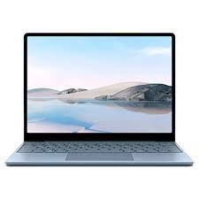
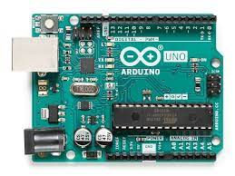
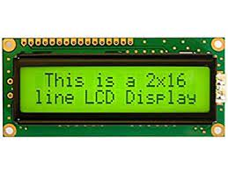
JUMPER WIRES:
LAPTOP:
ARDUINO UNO
16*2 DISPLAY:

Slide 6
SOFTWARE COMPONENTS AND DESCRIPTION
The Software Components used for interfacing the 16*2 LCD module with ARDUINO UNO is:
ARDUINO IDE
It is a cross platform application and called as ARDUINO INTEGRATED DEVELOPMENT ENVIRONMENT.
It works in WINDOWS , MAC OS , and even in LINUX .
And the programing coding language is C and C++.

Slide 7

CONTINUATION…….
The range of Arduino module is available including: ARDUINO UNO , ARDUINO MEGA , ARDUINO LEONARDO, ARDUINO MICRO and many more.
The IDE environment mainly contains two basic parts:- Editor and complier . The editor is used for writing the code and the complier is used for compiling and uploading the code.
SKETCH which is also known as main created on the IDE platform creates an HEX FILE which is then transferred and uploaded in the controller on the board.

Slide 8
What is lcd module ?
Here in our project we are going to use 16*2 LCD display to project the out put.
It is an electronic display module that uses liquid crystal to produce a visible image.
The operating voltage is 4.7v to 5.3v and the current required is 1mA.
It is an alpha numeric display module where it can print 16 characters in 2 rows.
Each character is build by 5*8 pixel box and can work on both 8bit and 4 bit mode.
LCD is available in Green and Blue light with 1280 pixels (5*8*32).
It can display any custom generated characters.

Slide 9
Continuation……..
There are total 16 pins in the LCD. They are:
Vss (Ground): It is connected to ground pin of Arduino .
Vdd (+5V): Powers the LCD with +5V (4.7V-5.3V) .
VE (Contrast) : Decides the contrast level of display . Grounded to get maximum contrast.
Register Select : Used for shift between command/data register .
Read/write: Used to read or write data. Normally grounded to write data to LCD.
Enable: Used to toggle between 1 and 0 for data acknowledgement .

Slide 10
CONTINUATION…
Data Pins (0-7): These are used for transferring 8 bit data. It also operated in 4bit mode but pins 4,5,6, and 7 will be left over.
LED Positive: Backlight LED pin positive terminal.
LED Negative : Backlight LED pin negative terminal.

Slide 11
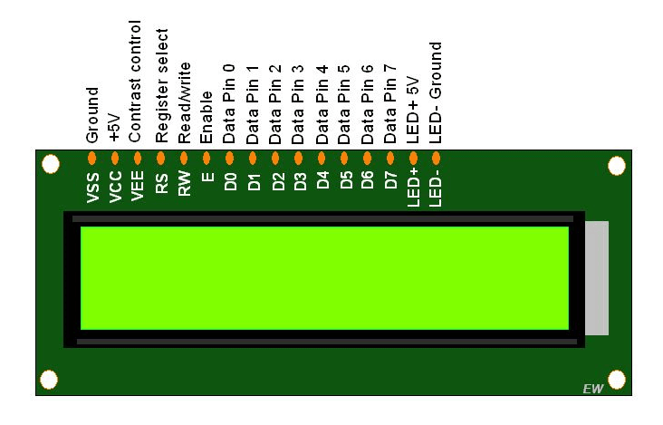
LCD MODULE PIN :

Slide 12
WHAT IS ARDUINO UNO ?
It is a microcontroller board developed by Arduino.cc and based on Atmega328 .
Arduino Uno is a very valuable addition in the electronics that consists of USB interface, 14 digital I/O pins, 6 analog pins, and Atmega328 microcontroller .
It also supports serial communication using Tx and Rx pins.
It is an open-source platform, means the boards and software are readily available and anyone can modify and optimize the boards for better functionality.
We power up the Arduino UNO with USB cable - when connected to the computer, provides 5 volts at 500mA.

Slide 13
CONTINUATION…….
The Arduino Uno has 6 analog pins, which utilize ADC (Analog to Digital converter).
Pins 0-13 of the Arduino Uno serve as digital input/output pins.
Pin 13 of the Arduino Uno is connected to the built-in LED.
In the Arduino Uno - pins 3,5,6,9,10,11 have PWM capability.
In Arduino, the PWM enabled pins produce a constant frequency of ~ 500Hz, while the duty cycle changes according to the parameters set by the user.
Serial (TTL) - Digital pins 0 and 1 are the serial pins of the Arduino Uno. They are used by the onboard USB module.

Slide 14
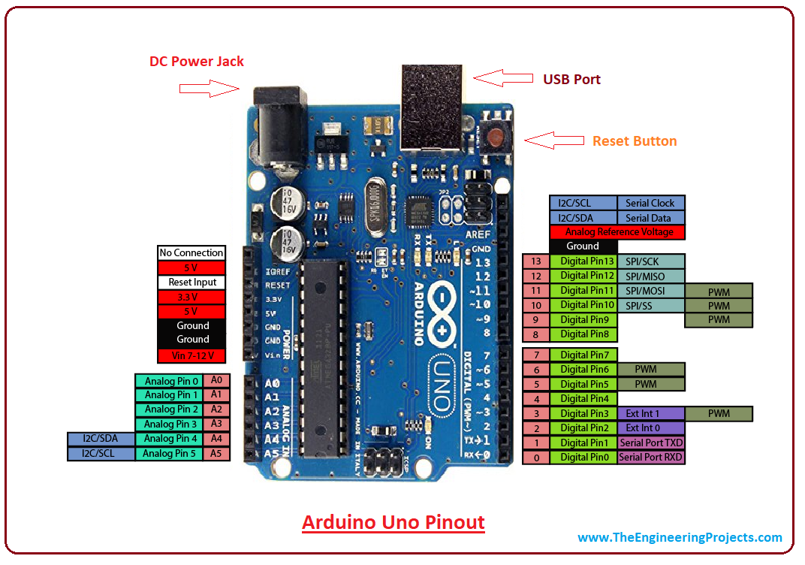
ARDUINO UNO PIN DIAGRAM:

Slide 15
CONNECTIONS
Now we need to connect the ARDUINO UNO with LCD display.
Firstly connect the Arduino UNO with the USB cable to the Laptop we are using and we can see that a green light pops up as a sign of device working.
Now take the LCD display and then connect the pins as given below:
The ground of LCD to ground of Arduino.
The VCC to +5V of Arduino.
SDA ( Serial data pin) : A4 ( Analog INPUT pin)
SCL ( Clock) : A5 ( Analog INPUT pin)

Slide 16
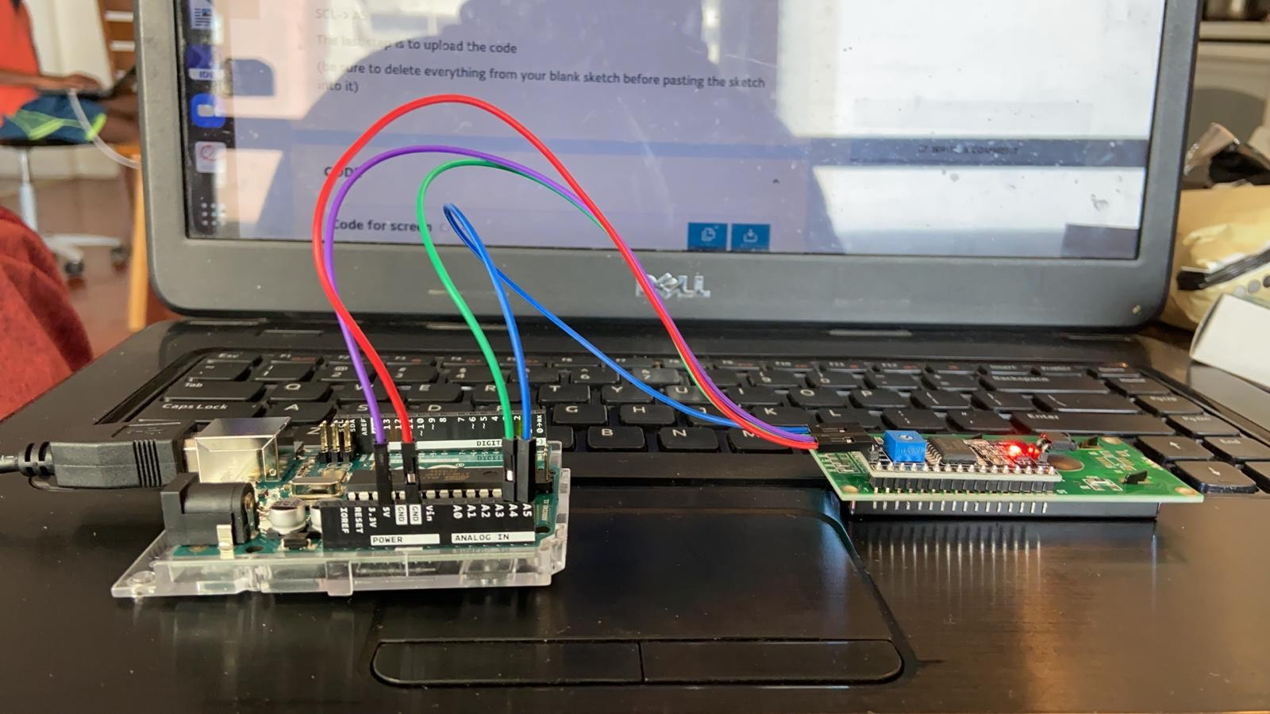

Slide 17
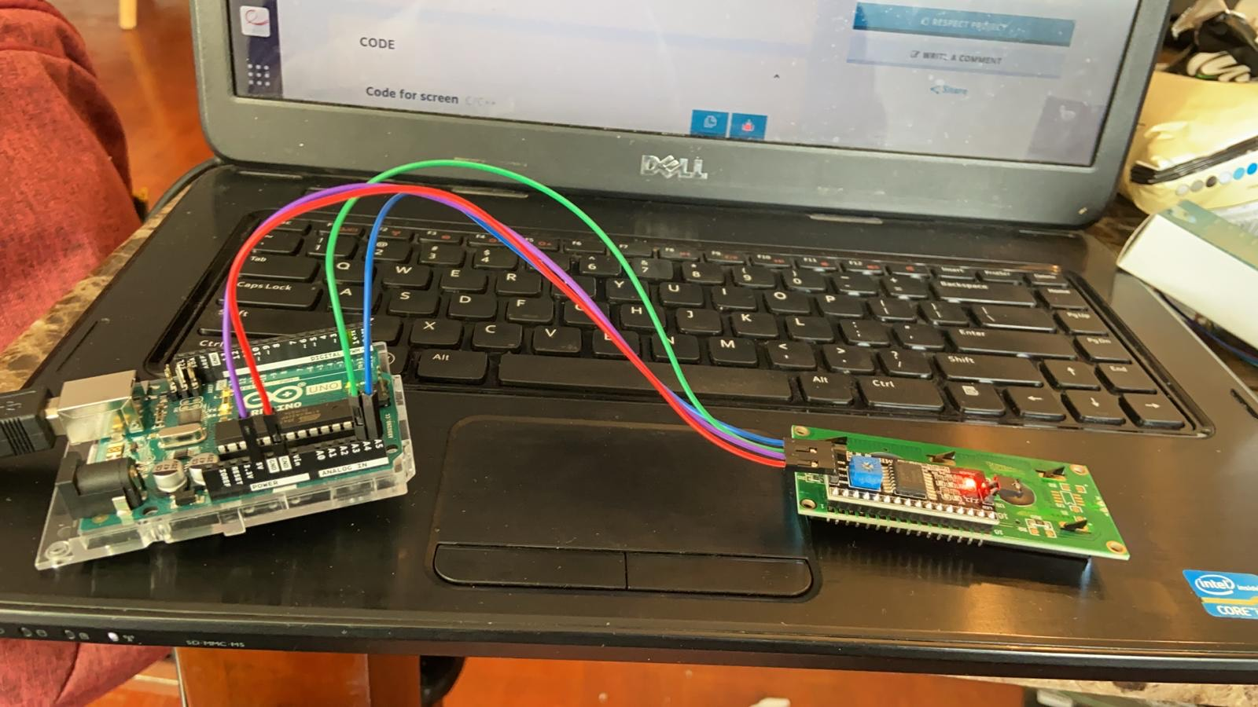

Slide 18
CODING AND INTERFACING
As a first step we used LIQUID CRYSTAL I2C as it’s the working library.
Add the libraries to ARDUINO UNO. The steps are:
Go to sketch in the tool bar.
Then select the include library option.
Click on add zip file.
Now search the file you need to add as the code.

Slide 19
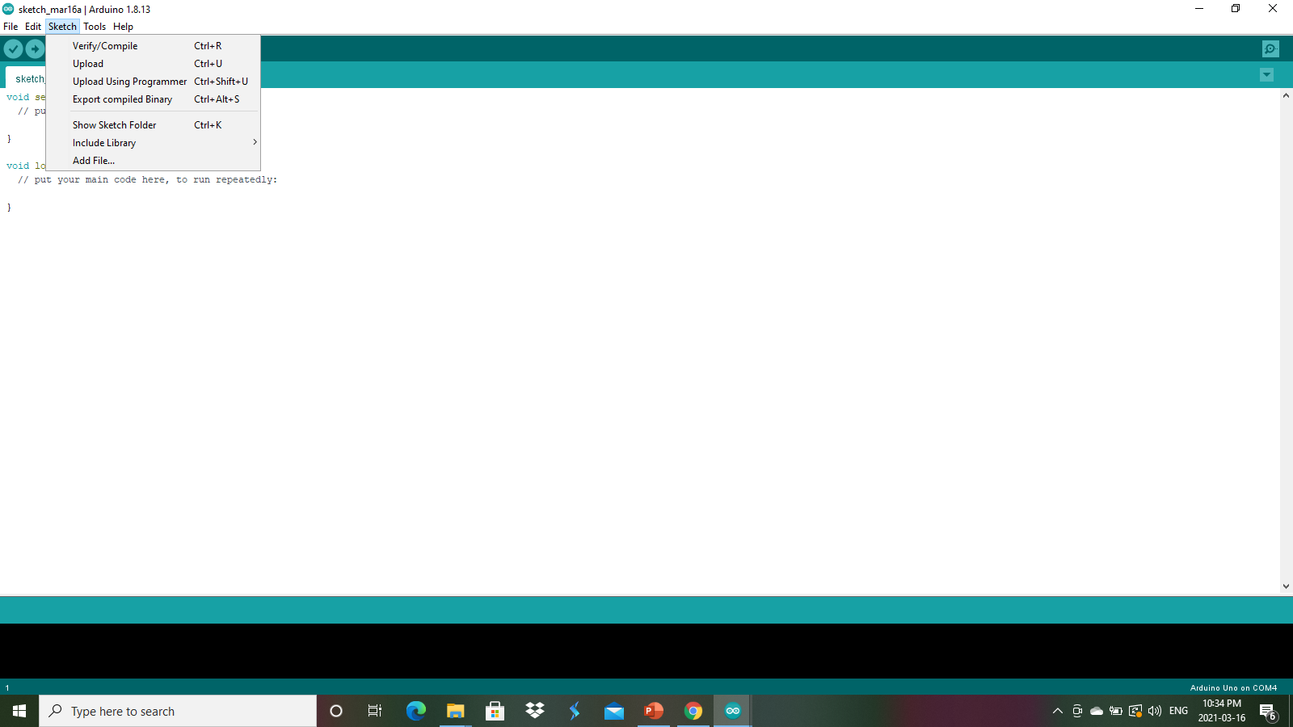

Slide 20
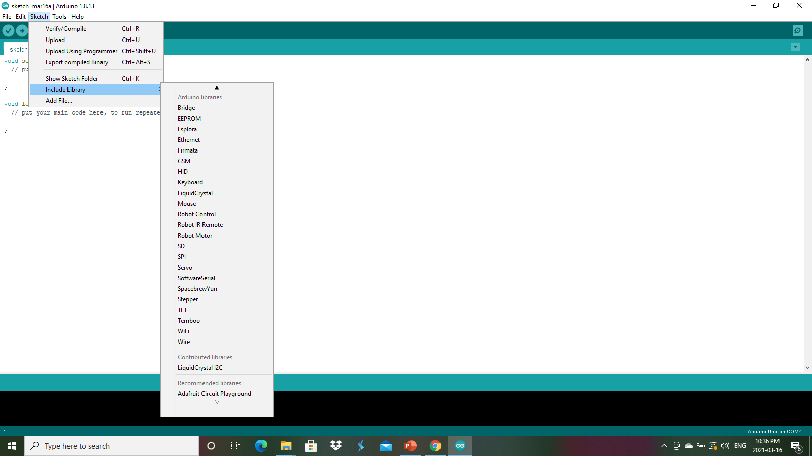
FINDING 12C LIBRARY:

Slide 21
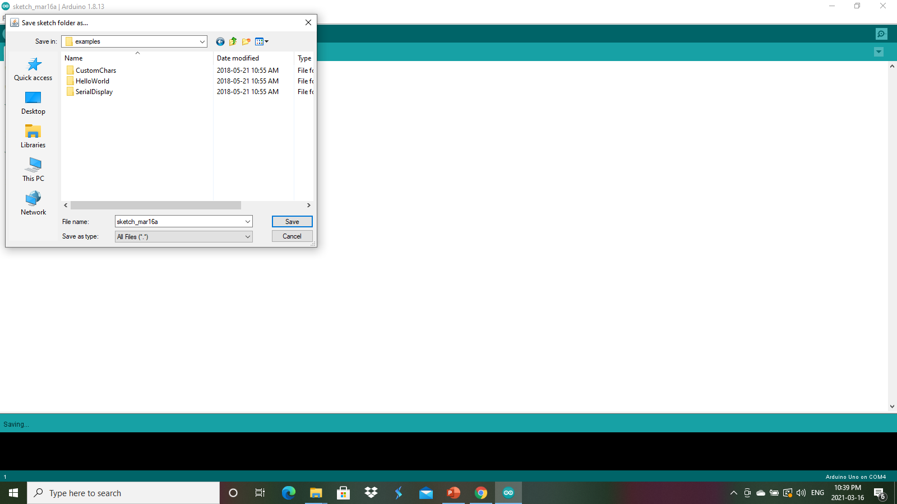
We have stored the files in examples. The codes which can display the output on screen.

Slide 22
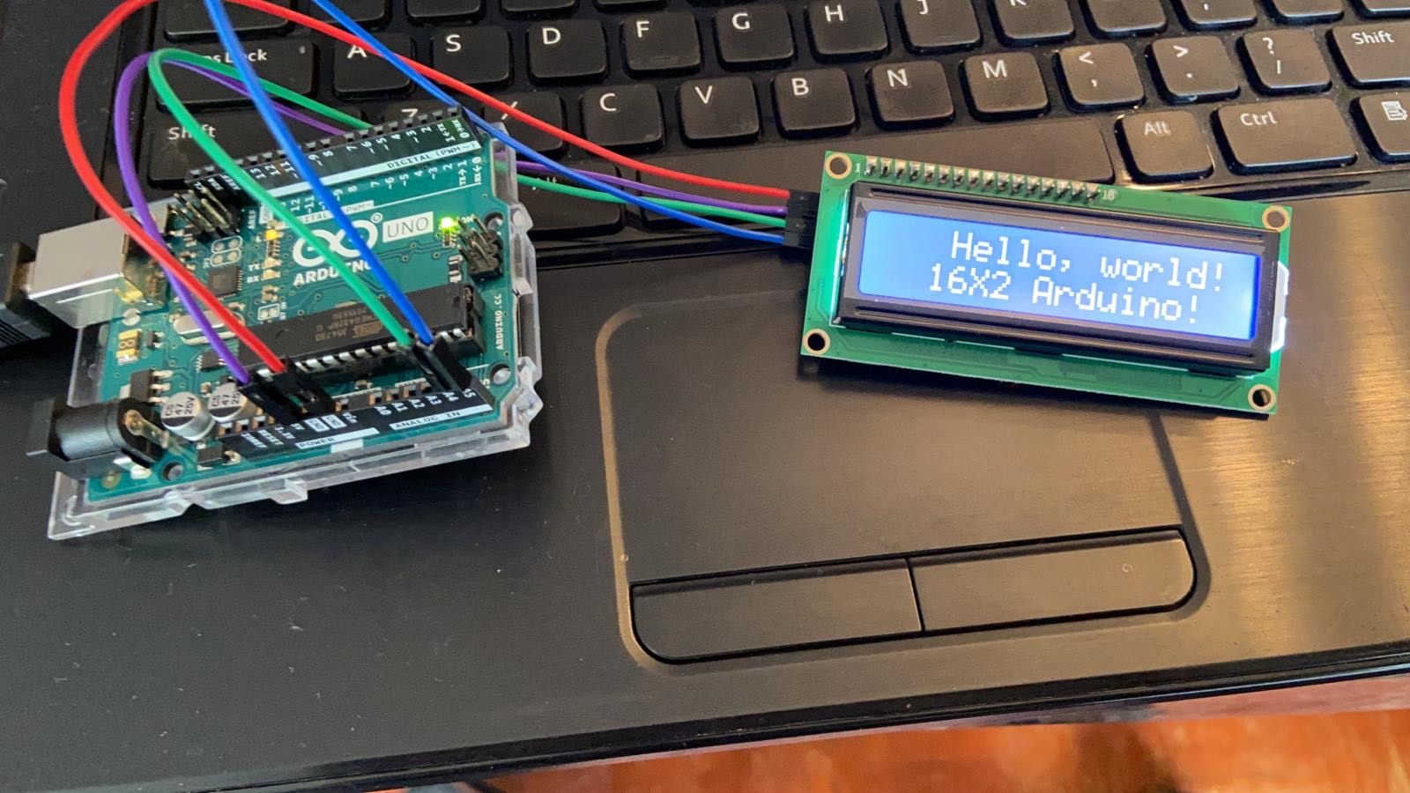
IN EXAMPLES THERE ARE SAMPLE CODES TO RUN AND WE CAN SEE THE OUTPUT.

Slide 23
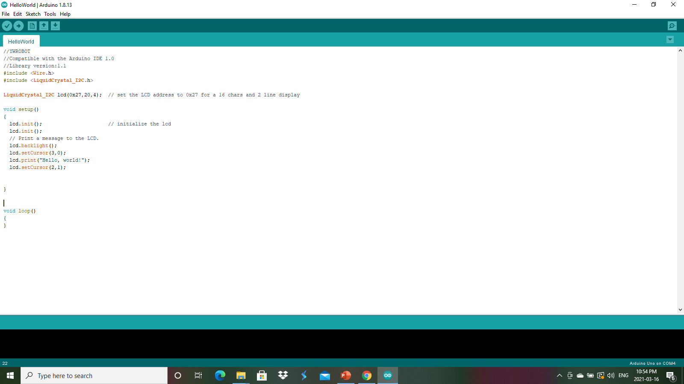
CODE

Slide 24
In the code lcd int is there to initialize the lcd
The set cursor() method is there to reposition the cursor .
Here we give the row and column position.
Lcd address is a place where the code is first stored.
Wire.h library is used to communicate with i2c device.

Slide 25
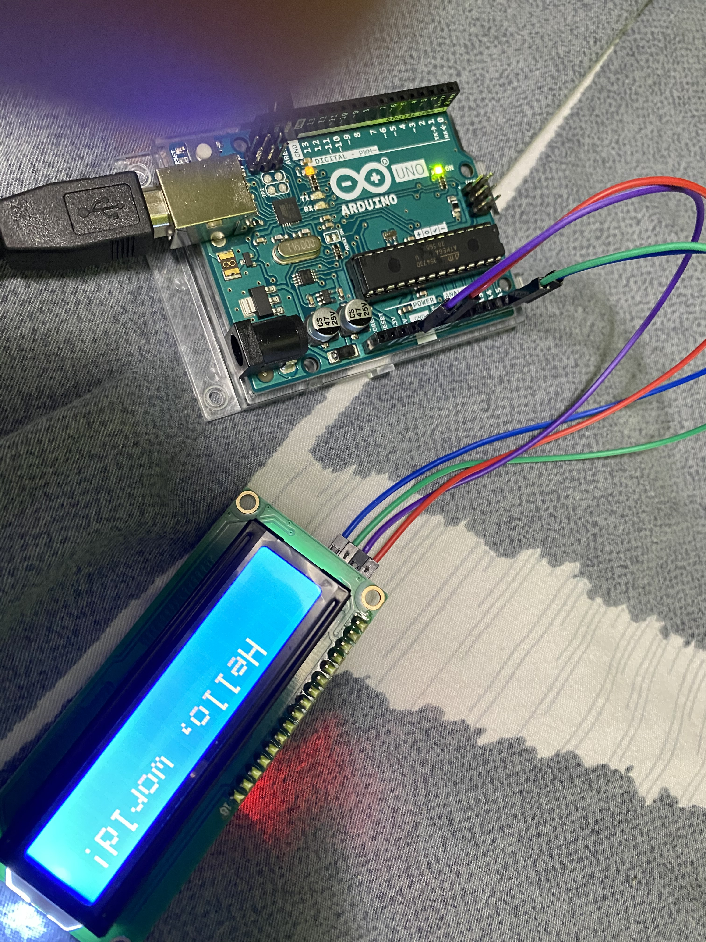
OUTPUT

Slide 26
REFERENCES
https://create.arduino.cc/projecthub/arduino_uno_guy/i2c-liquid-crystal-displays-5b806c
https://www.google.com/amp/s/www.theengineeringprojects.com/2018/10/introduction-to-arduino-ide.html/amp
https://components101.com/displays/16x2-lcd-pinout-datasheet

Slide 27
THANK YOU……

